Slide 1

Carbon Emissions Forecasting
Sylvia H. Florez
Final Report Aug 14, 2021
Applied Data Science Program . MIT-ADSP May21

Slide 2
Problem Overview
Context
The accumulation of atmospheric greenhouse gases, largely Carbon dioxide (CO₂) have led to global warming and changes in climate patterns.
A key source of CO₂ emissions is the burning of fuels to generate electricity.
Reduction of CO₂ emissions is urgent as the effects of climate change are showing severe consequences (water shortage, increased wildfires, intense storms and wildlife habitat destruction among many others).
Goals
To identify key contributors to CO₂ emissions from the electricity generation sector in the US
To forecast CO₂ emissions from natural gas source using historical data.
Motivation
Forecasting CO₂ emissions into the future is vital for planning as it can provide a benchmark for policy evaluation.
“In the future, we can compare actual data after a policy has been implemented to the historically based forecast(without the policy) to evaluate the effects of the policy”

Slide 3
Executive summary
Reduction of Carbon Dioxide (CO₂) emissions from the Electricity Sector is vital for reducing the effects of global warming.
CO₂ emission forecasting capability is key for planning as it provides a benchmark for policy evaluation.
Two models were selected based on their capability to predict data with seasonal dependence : Seasonal Arima and FB Prophet.
The models were studied in depth and compared in accuracy using a rolling time window approach know as cross-validation.
Model selection was based on lowest average error between prediction and actual data (unseen by the model), over various time frames.
Both models show very good forecasting performance but the Seasonal Arima (SARIMA) model with optimized parameters was found to produce most accurate forecast.

Slide 4
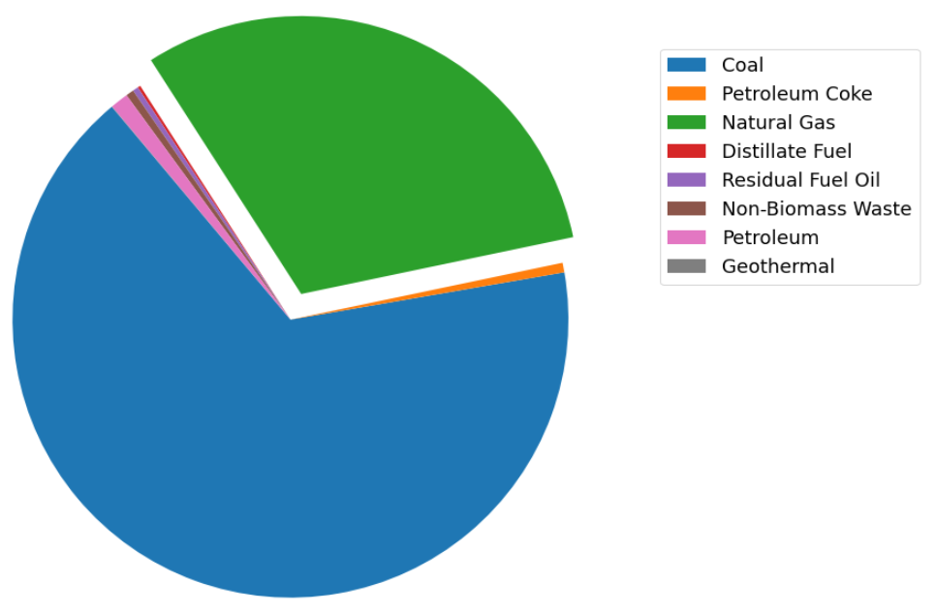
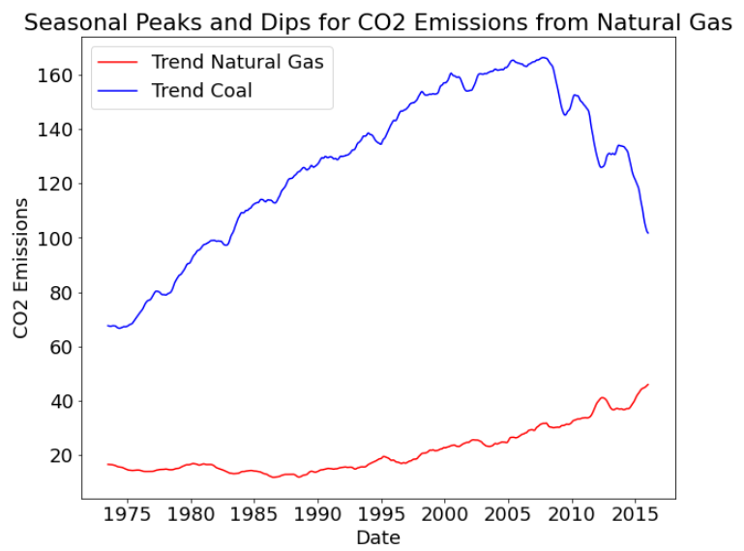
Data Insight
CO₂ emission for Jul-2016
Natural Gas
30.8%
EIA time series data for Electric Sector CO₂ emissions from various sources and for the time period of 1973-2016
Coal and Natural gas show highest contributions to CO₂ emissions
Coal CO₂ emissions over time show a steep increase from 1973 to 2007, followed by a reduction between 2008 and 2016.
Natural gas CO₂ emissions show low and flat contribution until the 1990’s, time from which a steady increase in the trend is observed.
Tradeoff between coal and natural gas sources is desirable given the higher efficiency of natural gas. Tradeoff may have influenced the opposing trend observed in the data.
Coal
66.6%
Average trend of the main contributors to CO2 emissions from the Electricity Sector
Data from the U.S. Energy Information Administration (EIA).

Slide 5
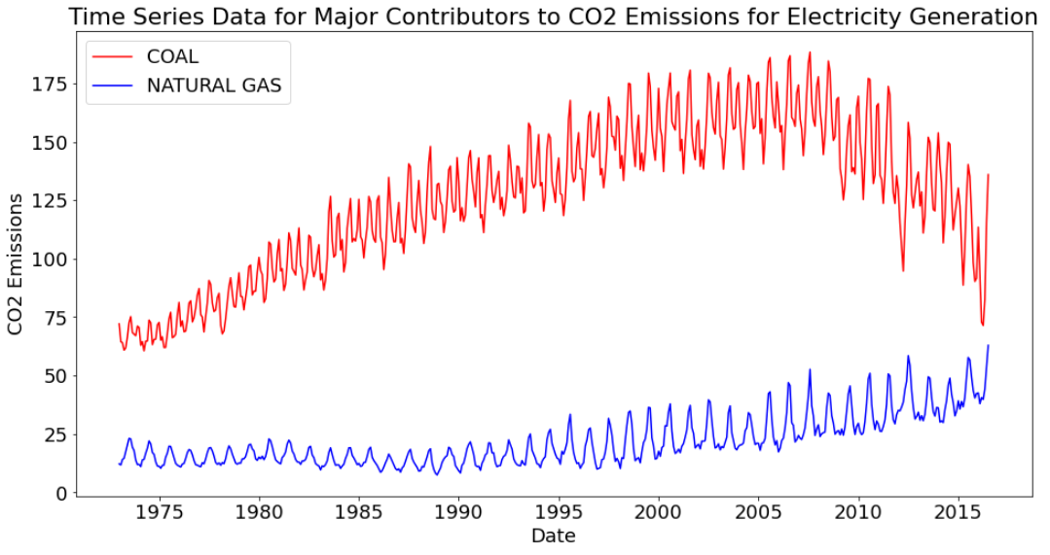
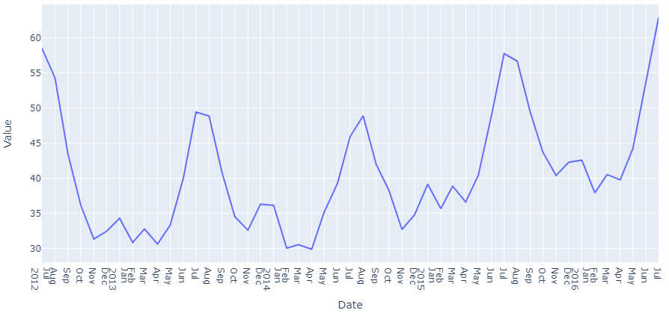
Data Insight
Strong seasonality observed in the cases CO₂ emissions from both coal and natural gas.
For the case of CO₂ emissions from natural gas source, the data shows 12 month seasonality with peaks in the months of July and Aug
Alternative energy technology and policies are likely driving down the CO₂ emissions from coal.
CO2 emissions from Natural Gas
Data from the U.S. Energy Information Administration (EIA).

Slide 6
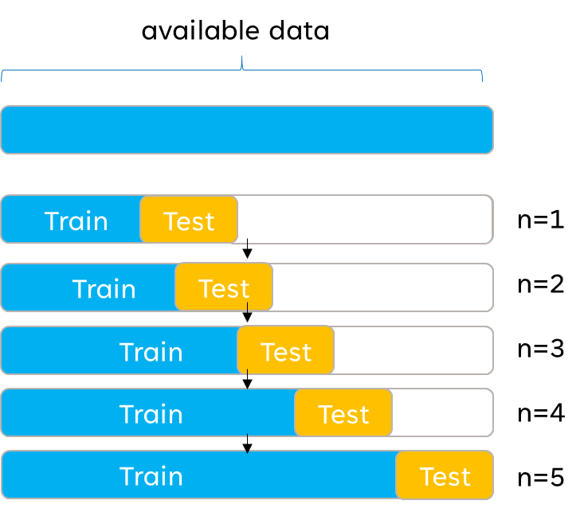
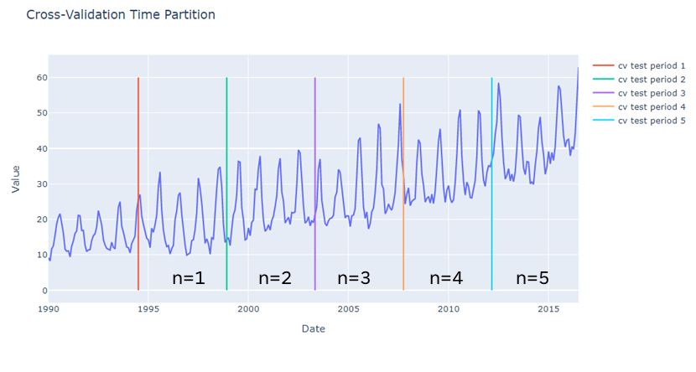
Problem and solution summary
Optimize hyperparameters for SARIMA(1,1,1)x(1,0,1,12) model using automated function auto-arima.
Build optimized SARIMA Model
Build FB Prophet Model
Use a moving window based technique known as cross-validation to determine which has better performance i.e. lowest average prediction error over all test windows (see below)
Select model with best performance (lowest error) and forecast natural gas CO₂ emissions into the future
Cross-Validation : select early subset of data to train the model and then evaluate the error between model forecast into the test period and the actual data in the test period. The test window or “horizon” is then moved forward in time and the model is retrained with a larger data set and the error evaluated. This process repeats for all horizons and the final error is the average of the errors corresponding to the different time frames.
CO2 emission from natural gas

Slide 7
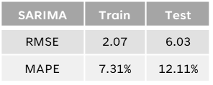
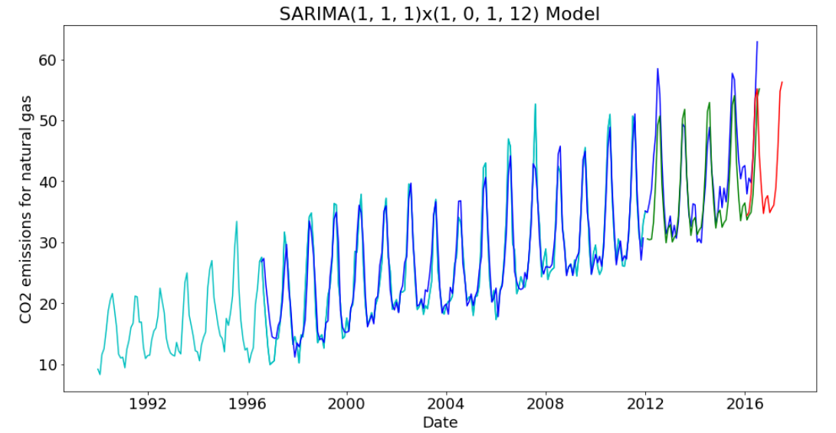
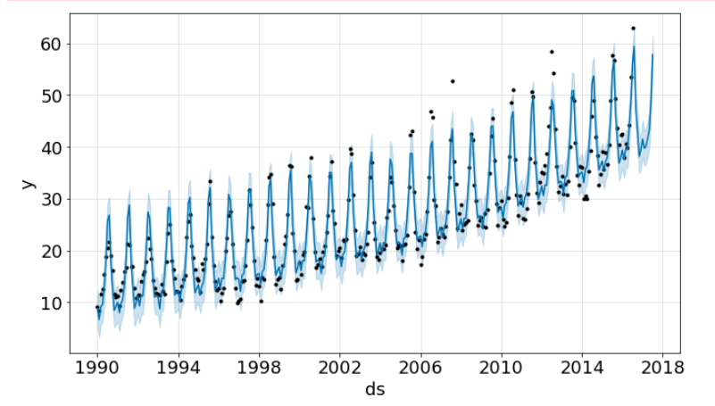
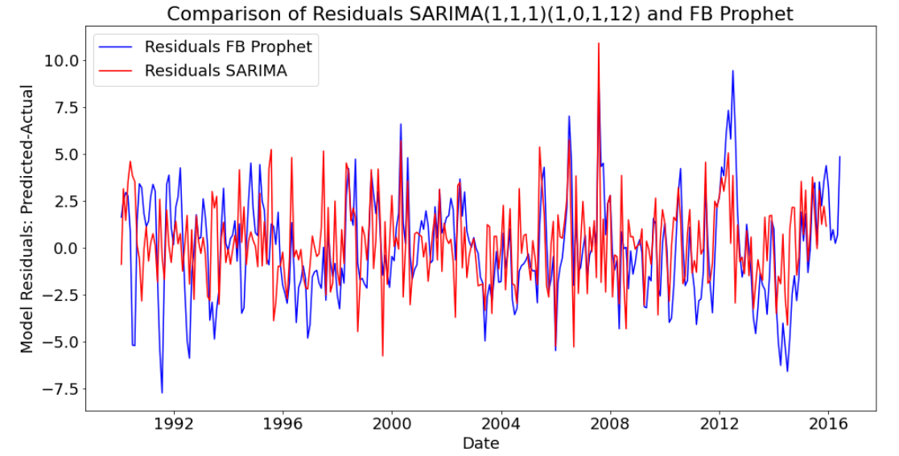
Optimized MODELS
Model 1 : SARIMA
“Seasonal autoregressive integrated moving average model with 12 month seasonality”
Model 2 : FB Prophet model
FB Prophet model with monthly data and additive seasonality
Actual data
Prediction train
Prediction on train and forecast
Actual data
Forecast
Prediction test
uncertainty intervals
Residuals are similar for both models
Comparison of residuals ‘Predicted-actual’ for both models

Slide 8
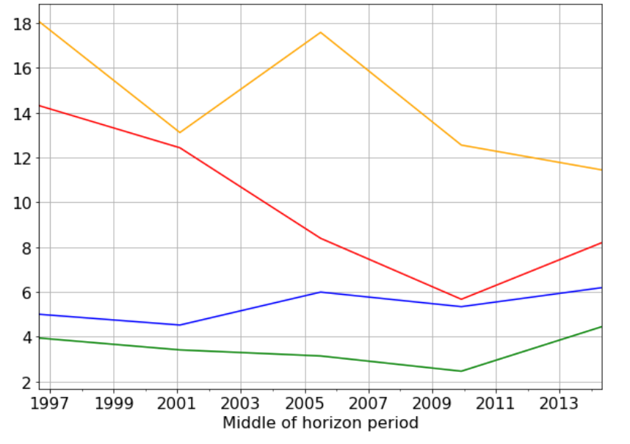
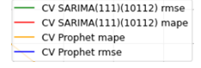
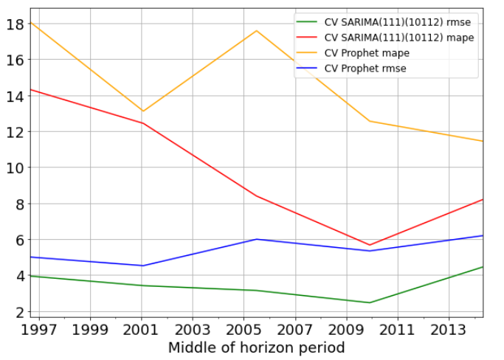
Model Performance Evaluation and Comparison
Cross-Validation Results SARIMA and PROPHET models
Error metrics used :
1) rmse : root mean square error
2) Mape : Mean absolute percentage error
Errors measured between the predicted data and the unseen test data in the cross-validation time frames.
The smaller the value the better the predictability of model
Final average obtained over all cross-validation horizons.
Prophet mape
Sarima mape
Prophet rmse
Sarima rmse
Model | MAPE average over 5 horizon | RMSE average over 5 horizon
SARIMA | 9.8% | 3.5
FB Prophet (additive seasonality) | 14.5% | 5.4
Better performance of SARIMA model
Prophet model also shows good performance in comparison to other models evaluated (Prophet with multiplicative seasoning or ARIMA (6,0,6))

Slide 9
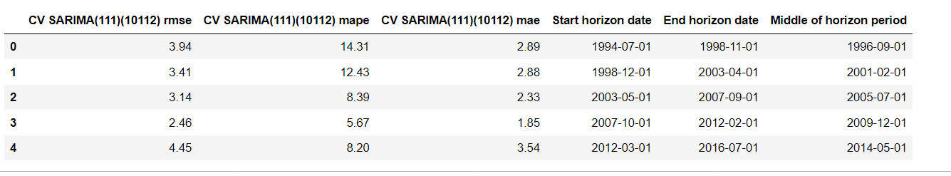
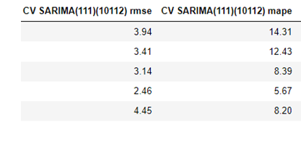
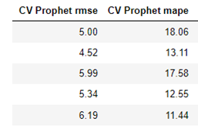
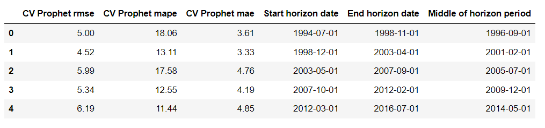
Cross-validation results by horizon
n=1
n=2
n=3
n=4
n=5

Slide 10
Recommendations for implementation
Recommend the SARIMA(1, 1, 1)x(1, 0, 1, 12) found to have lowest errors through cross-validation
Forecasted future CO₂ emissions should be used as a benchmark for policy evaluation i.e. as a comparison reference for actual future data
The recommended model SARIMAX has this capability of adding external variables for more complex modeling.
Possible to research effect of external variables (for ex. dependent on policy), on CO₂ emissions
However, if sudden trend changes in CO₂ emissions are observed, due to technology or policy, the SARIMA model would risk not capturing this behavior. In this case, the prophet model would be recommended as it has the capability to detect changes through change points.
Both models are not very computationally demanding and can be run on a variety of cloud servers such as Google Colab (even without enabling GPU)

Slide 11
THANK YOU

Slide 12
References
Pounds of CO₂ emitted per million British thermal units (Btu) of energy for various fuels:
https://www.eia.gov/electricity/data.php
https://www.eia.gov/electricity/
Coal (anthracite) | 228.6
Coal (bituminous) | 205.7
Coal (lignite) | 215.4
Coal (subbituminous) | 214.3
Diesel fuel and heating oil | 161.3
Gasoline (without ethanol) | 157.2
Propane | 139.0
Natural gas | 117.0

Slide 13
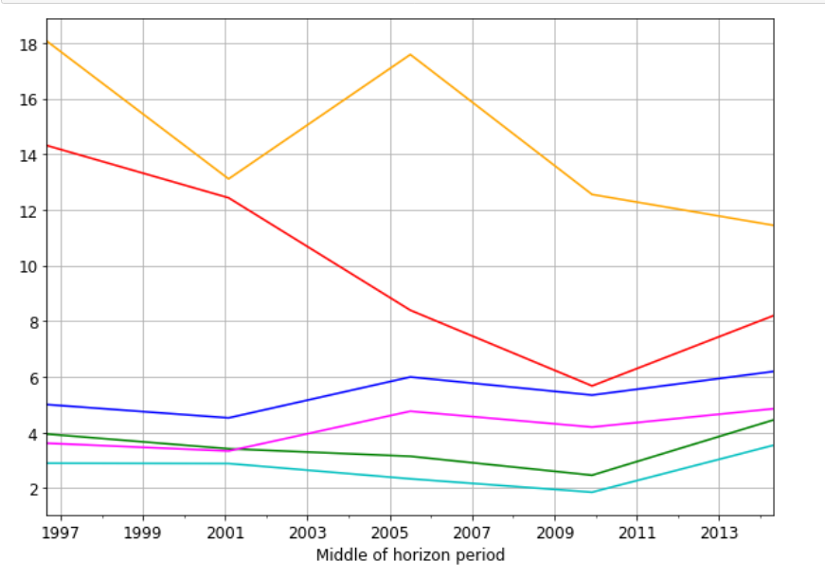
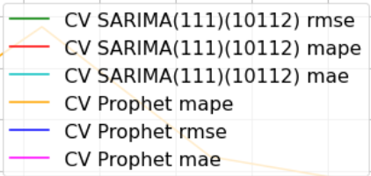

Slide 14
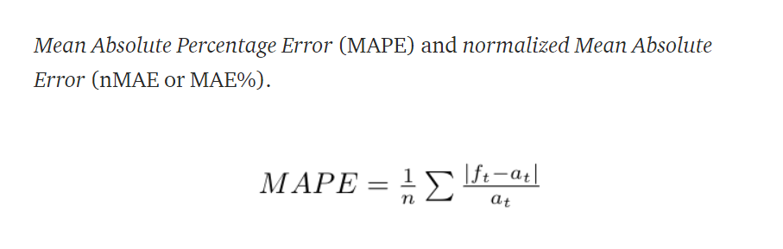
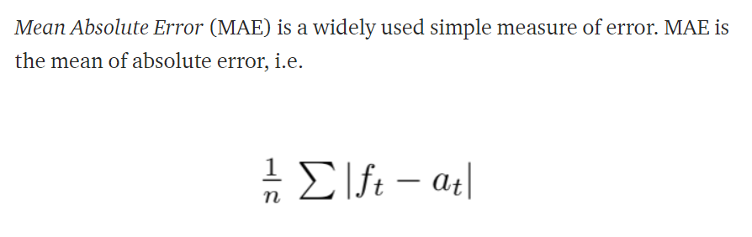
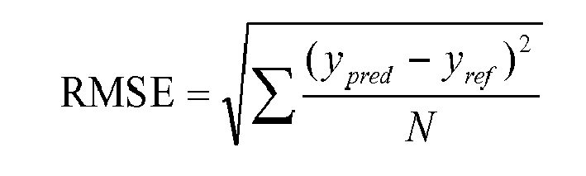
Errors

Slide 15
How is CO2 is generated?
How much CO₂ is generated when a fuel is burned is a function of the carbon content in that fuel. The heat content, i.e. the energy produced when a fuel is burned, is mainly determined by the carbon (C) and hydrogen (H) content. Heat is produced when C and H combine with oxygen (O) during combustion. Natural gas is mostly methane (CH₄), which has a higher energy content relative to other fuels, and thus, has a relatively lower CO₂-to-energy content.
Water and other elements, noncombustible elements (such as sulfur) in some fuels, reduce their heating values and increase their CO₂-to-heat contents

Slide 16
What is sarima?
ARIMA models are generally denoted ARIMA ( p, d, q) where parameters p, d, and q are positive integers.
p is the order (number of time lags) of the autoregressive model,
d is the degree of differencing (num times the data have had past values subtracted)
q is the order of the moving-average model.
SARIMA is represented as SARIMA(p,d,q)(P,D,Q,S)
In SARIMA(p,d,q)(P, Q, D,S): S is the seasonal factor. It’s the number of time steps for a single seasonal period.
The (P, D, Q) are the analogs of (p, q, d), except for the seasonal components.
Seasonal Autoregressive Integrated Moving Average with exogenous variables (SARIMAX):
Model parameters, obtained through automated optimization procedure ‘auto-arima’ function that steps through parameter space automates forecasts and minimizes of the error between unseen existing data and model forecast, over the same periods.

Slide 17
What is Petroleum Coke?
Petroleum coke, “petcoke”, is a carbon-rich solid material that is a product from oil refining, and is one type of the group of fuels referred to as cokes.
Petcoke is the coke that, derives from a final “cracking” process—a thermo-based chemical engineering process that splits long chain hydrocarbons of petroleum into shorter chains. (Other types of coke are derived from coal.)
In short, coke is the "carbonization product of high-boiling hydrocarbon fractions obtained in petroleum processing".

Slide 18
Capstone Project Carbon Emissions Forecasting
Sylvia H. Florez
Applied Data Science Program . MIT-ADSP May21

Slide 19
Problem Statement
To build a time series model that can reliably predict CO₂ emissions from natural gas source using historical data.
Time Series Modelling Approaches
Investigate prediction using classical ARIMA model. A log transformation followed by single period differencing is used to achieve stationarity. Data shows a flat rolling average trend for earlier dates followed by an increasing slope trend for more recent dates. Removal of early data was used to isolate the single more recent trend. This resulted in better prediction and forecasting. Higher order ARIMA model was expected following the behavior of the ACF and PACF on the transformed series.
Build model using Seasonal ARIMA (SARIMA), selected based on the strong seasonality observed in the data. Several techniques for hyperparameter optimization including grid search (rmse based) and auto_arima optimization were used.
Modeling approaches

Slide 20
Model 1- ClassicaL ARIMA with optimization
Stationarity achieved prior to modeling by log transformation followed by a single period shift. Transformed series shows flat moving average and roughly flat standard deviation. Dickey-Fuller test p-value value confirmed to be low after both transformations thereby confirming stationarity.
2. Data split into train and test as follows :
Time range for modeling (df_train) :1983-01-01 to 2014-01-01
Start train data with 1983 instead of 1973 to isolate single rolling average increasing slope trend.
Time range for testing (df_test): 2014-01-01 to 2016-07-01
3. Grid search implemented to optimize the p and q values of the ARIMA model, allowing for both auto regressive and moving average terms up to 6th order. Optimization metrics of rmse, BIC and AIC were used. Differencing term d set to zero as the input series already has single period differencing and is stationary. ACF and PACF suggests high order is needed. Exploration of the effects of p and q components on the model suggest p=q=6 are found to be optimum. Higher orders of p and q up to 12 were also explored but showed little or no gain.
4. Model evaluated for train and test data.
5. Forecast provided using the optimized fit model for the time range between 2016-07-01 to 2017-07-01

Slide 21
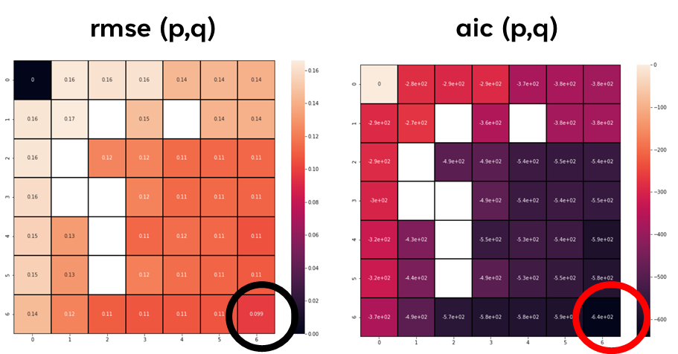
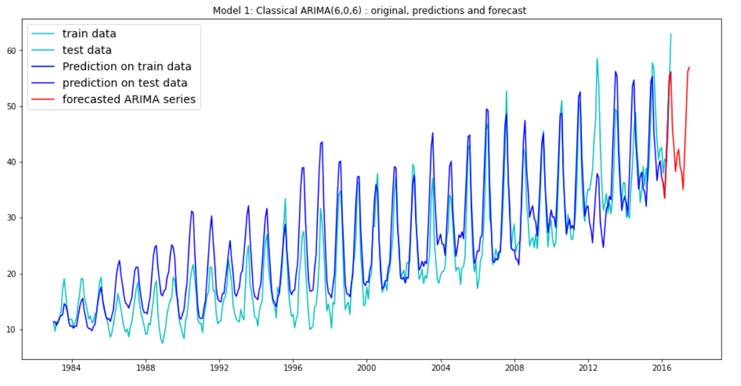
Optimum model 1 : ARIMA (6,0,6)
Model | RMSE train | MAPE train | RMSE test | MAPE test
Model 1: ARIMA (6,0,6) | 5.23 | 22.32% | 5.87 | 11.6%
(p,q) optimization 0-6 suggest 6th order MA and AR terms.
Higher orders were explored but resulted in higher complexity models with worse performance.
d=0 as differencing done prior to building model.
RMSE and Mean Absolute Percentage Error are listed in the table for predictions on train and test data.
The prediction on the test data shows lower MAPE(11.6%) than on the train data (22.3%) validating the model.
Cross-Validation of this time series model, by splitting the data into several ranges, is recommended for final hyperparameter model validation.
Removing early data that showed flatter rolling average trend than the later data, was key to success of this model.

Slide 22
model 2 :SARIMA (p,d,q)x(P,D,Q,S) = (1, 1, 1)x(1, 0, 1, 12)
1. Data split into train and test as follows
Time range for modeling (df_train) :1983-01-01 to 2014-01-01
Time range for testing (df_test): 2014-01-01 to 2016-07-01
Model used also for forecasting data into future time frame 2016-07-01 to 2017-07-01
df_train was input directly (no differencing) as d=1 was set together with the seasonal differencing S=12 in the model.
Optimization for SARIMA model :
a. Grid optimization with p,d,q in range(0,2) and using period 12 for seasonal differencing.
Minimization of rmse indicates: (pdq)x(P,D,Q,S) = (1, 1, 1)x(1, 0, 1, 12)
b. Optimization with auto_arima, using aic metric also gives : Best Model: SARIMAX(1, 1, 1)x(1, 0, 1, 12)
→ Same SARIMA hyperparmeters found by the two methods
4. Model evaluated for train and test data.
5. Forecast provided using SARIMAX(1, 1, 1)x(1, 0, 1, 12) for time frame between 2016-07-01 to 2017-07-01.

Slide 23
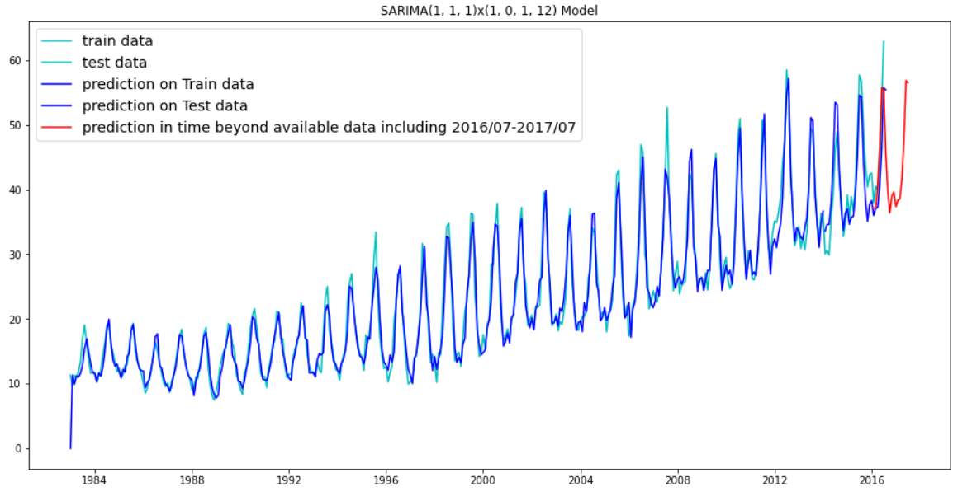
model 2 :SARIMA (p,d,q)x(P,D,Q,S) = (1, 1, 1)x(1, 0, 1, 12)
RMSE and Mean Absolute Percentage Error MAPE obtained on train and test data.
The rmse and MAPE on the train data is very good and better than on the test data. The MAPE on train is 7.3%.
The prediction on the test data shows higher rmse and higher MAPE(12.11%) than on the train data. This raises some concern of overfitting that will be further investigated. Will run model with larger test/smaller train to investigate further.
SARIMA model is more robust and less sensitive to input time frame (as was shown to be the case for the classical ARIMA(6,0,6)
Cross-Validation of this time series model, by splitting the data into several ranges, is recommended for final hyperparameter model validation.
Cross-Validation is strongly recommended for the SARIMA(1, 1, 1)x(1, 0, 1, 12) model as there is some suggestion of potential overfitting in the very low RMSE for the train data.
SARIMA (1, 1, 1)x(1, 0, 1, 12) and ARIMA(6,0,6) show similar MAPE near 12% for the test data.
RMSE and MAPE Comparison
Model | RMSE train | MAPE train | RMSE test | MAPE test
SARIMA(1, 1, 1)x(1, 0, 1, 12) | 2.07 | 7.31% | 6.03 | 12.11%
RMSE and MAPE Comparison
Model | RMSE train | MAPE train | RMSE test | MAPE test
ARIMA (6,0,6) | 5.23 | 22.32% | 5.87 | 11.58%
SARIMA (1, 1, 1)x(1, 0, 1, 12) | 2.07 | 7.31% | 6.03 | 12.11%

Slide 24
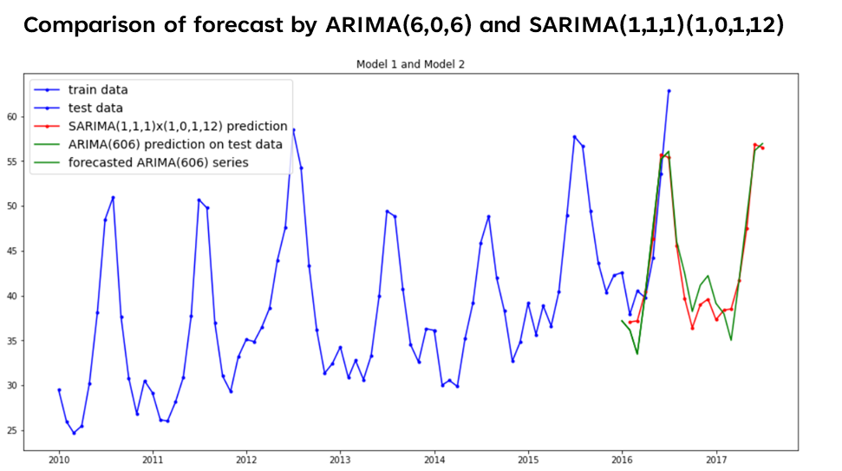
Proposal for the final solution design
Both the Classical ARIMA(6,0,6) and SARIMA(1, 1, 1)x(1, 0, 1, 12) were found to show good predictability with MAPE on the test data is similar and near 12% for both models.
Forecasted NNEIEUS emissions are very similar for both models built.
While the SARIMA model is expected to handle seasonality better and is likely a more robust model, signs of potential overfitting require further investigation before implementation.
Key recommendations for the criterion (implementation)
Recommend the more robust SARIMA(1, 1, 1)x(1, 0, 1, 12) if overfitting can be discarded.
Further validation of these hyperparameters recommended through cross-validation.
SARIMA (1, 1, 1)x(1, 0, 1, 12) model, is likely a more robust model that can better handle variations in out of sample data.
If SARIMA (1, 1, 1)x(1, 0, 1, 12) model found to overfit, then ARIMA(6,0,6) can be implemented.
For clasical ARIMA(6,0,6), older data with flatter CO2 trend, needs to be excluded from the train data.
References
https://www.eia.gov/electricity/data.php
https://www.eia.gov/electricity/

Slide 25
THANK YOU

Slide 26
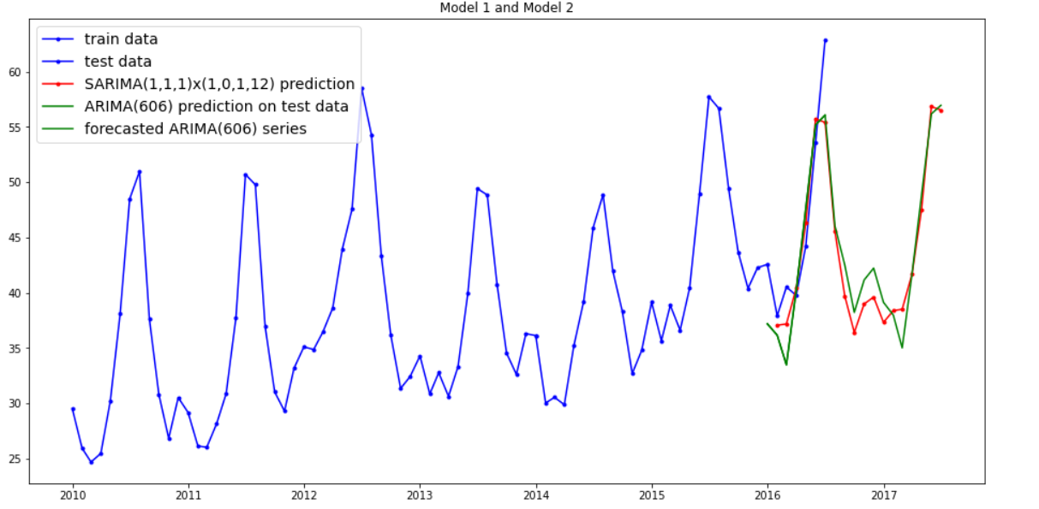
model Comparison
RMSE and MAPE Comparison
Model | RMSE train | MAPE train | RMSE test | MAPE test
ARIMA (6,0,6) | 5.23 | 22.32% | 5.87 | 11.58%
SARIMA (1, 1, 1)x(1, 0, 1, 12) | 2.07 | 7.31% | 6.03 | 12.11%
1. und to be optimum. Higher orders of p and q up to 12 were explored showing little or no gain.
Comparison of forecast by ARIMA(6,0,6) and SARIMA(1,1,1)(1,0,1,12)
Forecasted NNEIEUS emissions are very similar for both models.
Maintained or increased NNEIEUS CO2 emissions are desirable as this fuel for electricity generation is more efficient and reduction of coal contribution (replacement by natural gas) is desirable.
Possible to consider coal contribution to CO2 emissions as an exogenous regressor in the model.

